Slide 1
COMP6115 Object Oriented System Analysis and Design DIGITAL CONTENT Session # 2

Slide 2
Learning Objective
Understand the basic idea of drawing the class diagram used in UML approach of object oriented analysis and design.

Slide 3
COMP6115 Object Oriented System Analysis and Design DIGITAL CONTENT: Structural Modeling – Class Diagraming Session # 5

Slide 4
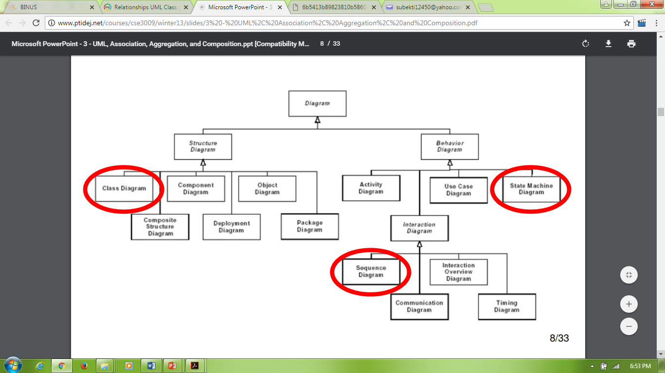
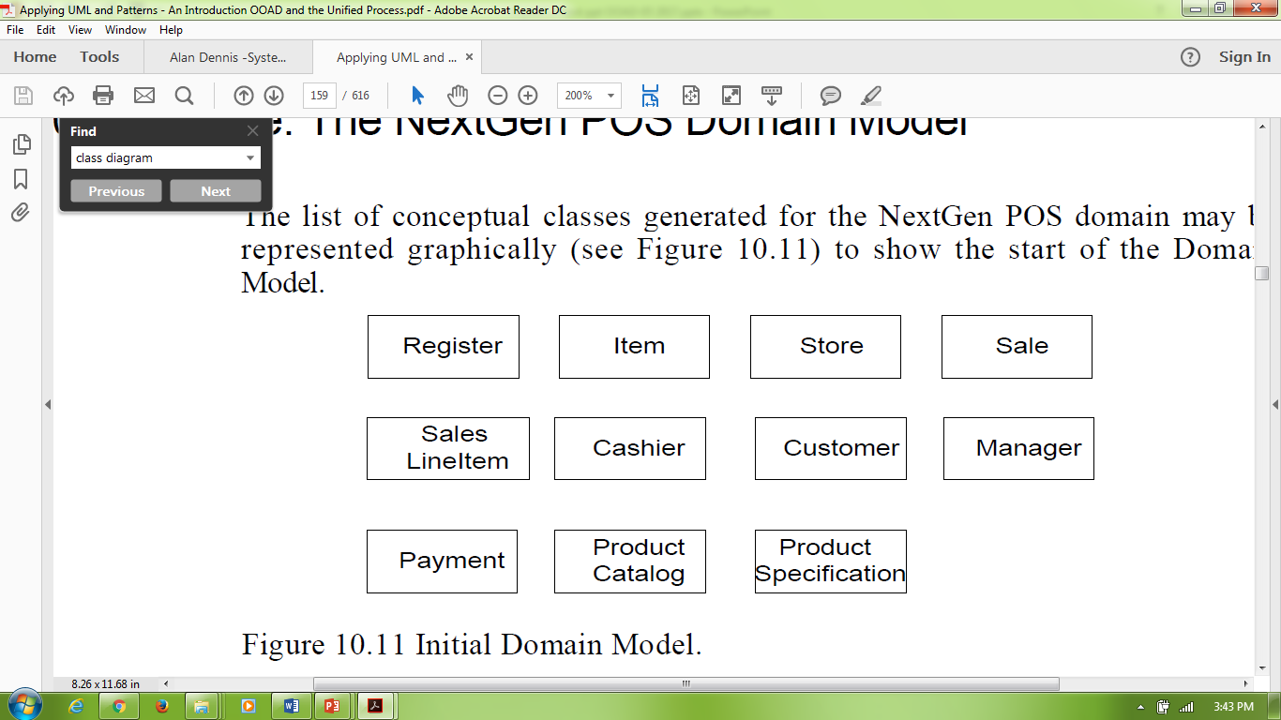

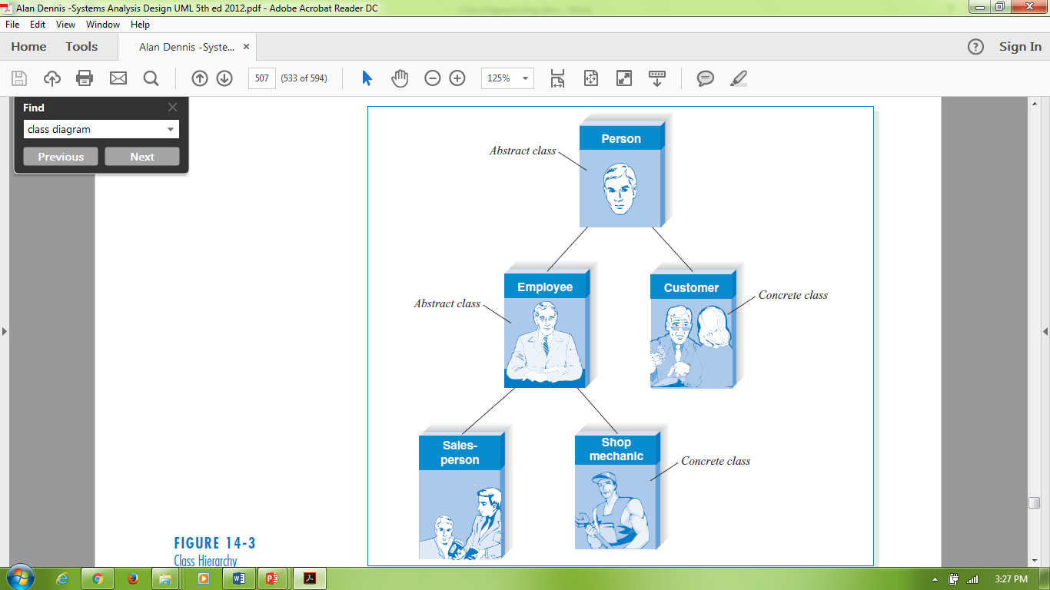
UML Diagrams

Slide 5
Objects (Domain Model)

Slide 6
Object-to-Class Modelling
Class Name
- Attributes List
+Methods() List
Customer
customerId
..
..
+getAge()
+ …

Slide 7
Notation of Class
Customer
- customerId
- firstName
- lastName
- dateOfBirth
- address
Class Name
Attributes
- getAge()
- displayOrder()
- registration()
Methods

Slide 8
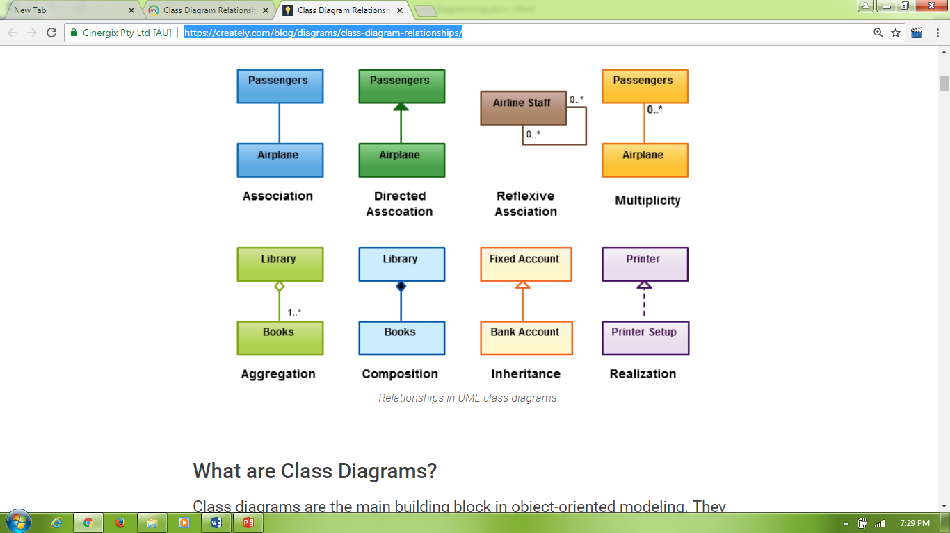
Relationship in UML
Source: https://creately.com/blog/diagrams/class-diagram-relationships/

Slide 9
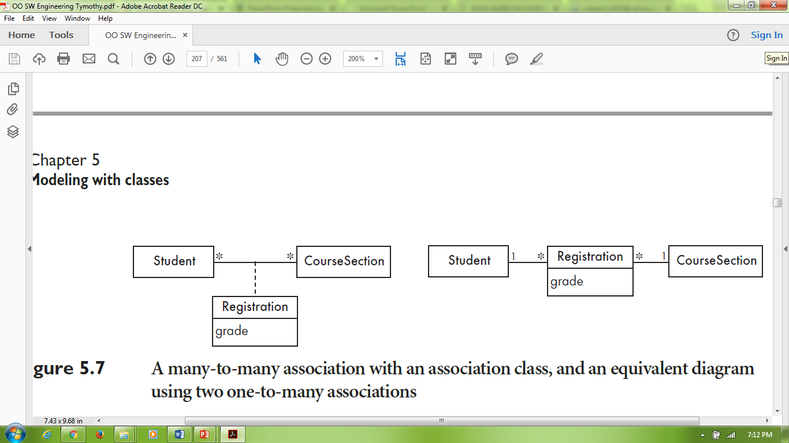
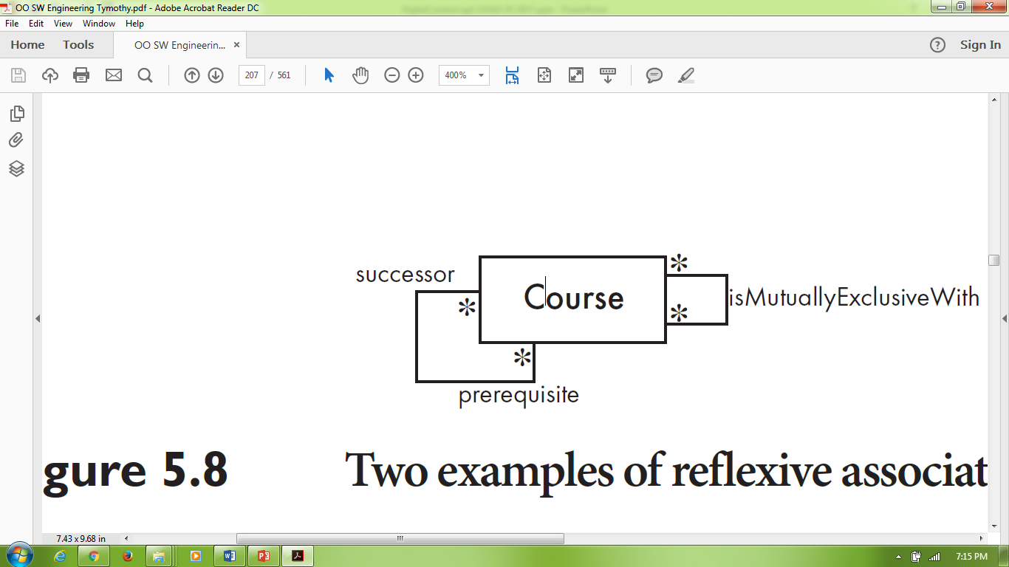
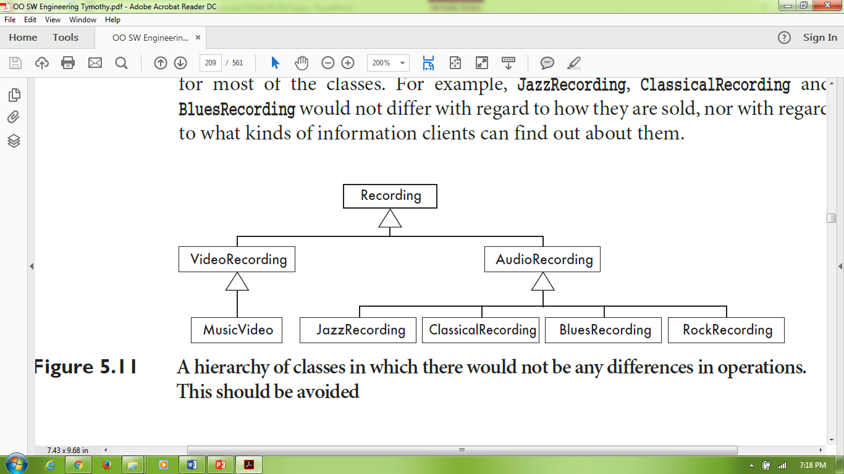
Relationships type examples
Source: Timothy C. Lethbridge

Slide 10
References:
https://en.wikipedia.org/wiki/Reusability, (2018)
Kenneth S. Rubin , (2014), A Practical Guide To The Most Popular Agile Process, ISBN-10: 0-13-704329-5, Edwards Brothers Malloy, Ann Arbor, Michigan.
Nishadha, (2018), UML Class Diagram Relationships in Explained with Examples, https://creately.com/blog/diagrams/class-diagram-relationships
Roberta M. Roth, Alan Dennis, Barbara H. Wixom, (2013), Systems Analysis and Design, 5th edition, ISBN: 978-1-118-09374-0, John Wiley& Sons, Inc, Singapore
Sametinger, Johannes(2018), Software Engineering with Reusable Components, https://www.springer.com /us/book/9783540626954 (book preview)
Timothy C Lethbridge, Robert Laganiere, (2005), Object-Oriented Software Engineering, ISBN 0-07-70109082, McGraw-Hill Education, Glasgow, UK

Slide 11
Acknowledgement
This digital content has been developed by the Faculty Member of SCS in Advanced Software Engineering to give an illustration of the Object Oriented System Analysis and Design.

